Slide 1
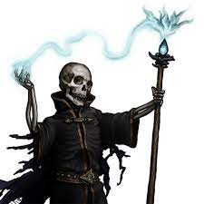
The Night of the Lich
Pitch Date: 12/18/2022 Update 2/26/2023
Release Date: 4/9/2023 178 Commits (+4)
Team Lead: Vince McKeown 11 Contributors
1
2
3
4
5
6
7
8
9
10
11
12
13
14
15
16

Slide 2

Tylor Allison
Bush art

Slide 3
H Trayford
Thought bubble stays on screen

Slide 4
Christer “McFunkyPants” Kaitila
Lich now emits pulsing green glow

